Slide 1

A fundamental problem at large…
Centralized secret management
At the heart of many (ironically) decentralized systems
E.g., use Coinbase to store Bitcoin keys
decentralization
Secret management

Slide 2
A classic solution (Shamir 1979)
S₁
any t+1 of n shares
S₂
SK
SK
…
S_{n}
A committee of n nodes hold the secret collectively
Harder to attack: must corrupt at least t+1 nodes
Threshold cryptography: (e.g.) sign without reassembling SK

Slide 3
S₁
any t+1 of n shares
S₂
SK
SK
…
S_{n}
Mobile Adversary
Requires a static committee
Choose a t-deg random polynomial such that P(0)=SK
Share Si=P(i)
Any t+1 shares can interpolate P(x) and SK

Slide 4
Mobile adversaries
Overtime adv may eventually compromise t+1 nodes
Limit the corruption rate (instead of the absolute number)
P(1)
P(1)+Q(1)
Proactivization
(every epoch)
P(2)
Generate Q(x) s.t. Q(0)=0
P(2)+Q(2)
…
…
P(n)
P(n)+Q(n)
Green shares and blue ones are incompatible!

Slide 5
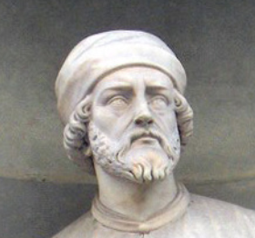
Node churn
Secret S
Next epoch
Secret S
committee at time T
Committee at time T+1

Slide 6



Secret sharing no longer works
A mobile adversary can corrupts t nodes in each committee
2t shares give away the secret!
E.g., a naïve (1, 3)-SS:
Naïve direct handoff
P(1)
P(1)
P(2)
P(2)
P(3)
P(3)

Slide 7
Needs a practical solution
Previous works used a “blinding” trick
O(n⁴) complexity
Unfortunately, doesn’t scale to large systems
5.3GB / epoch, for a committee of 100 nodes,

Slide 8
CHURP: Dynamic-Committee Proactive Secret Sharing
Sai Krishna Deepak Maram, Fan Zhang, Lun Wang, Andrew Low, Yupeng Zhang, Ari Juels and Dawn Song. In submission.
https://eprint.iacr.org/2019/017

Slide 9
CHURP’s main idea
Making 2t shares insufficient to recover SK
“dilute” the share > proactivize > “concentrate”
(1, 3)-SS
P(1)
(2, 3) of P(1)
P(2)
1 green, 1/2 blue and red
Not enough!
P(3)

Slide 10
Do it efficiently (Technical details)
Use a bivariate (t, 2t)-deg poly B(x, y) such that B(0, 0)=SK
Full shares (2t degree polys): B(i, y)
Reduced shares (t-degree polys): B(x, i)
The secret SK can be recovered from
t full shares, OR
2t reduced shares
“Dimension-switch”: dilute by switching to the 2nd dimension

Slide 11
Epoch e
Epoch e+1
B(1, y)
B(x, 1)
B’(x, 1)
B’(1, y)
Generate Q s.t. Q(0, 0)=0
B(2, y)
Dimension switch
B(x, 2)
B’(x, 2)
Dimension switch
B’(2, y)
…
…
…
…
…
B(n, y)
B(x, n)
B’(x, n)
B’(n, y)
“Dilute the secret”
“proactivze”
“Concentrate again”

Slide 12
Efficient Proactivization
Generate Q such that Q(x, y)
A naïve solution takes O(n^3)
> Don’t need Q(x, y), just Q(x, j) is enough
2t nodes generate s_{i} [takes O(n^2)]
Set Q_{j}(x, j) = R_{j}(x) and share [another O(n^2)]

Slide 13
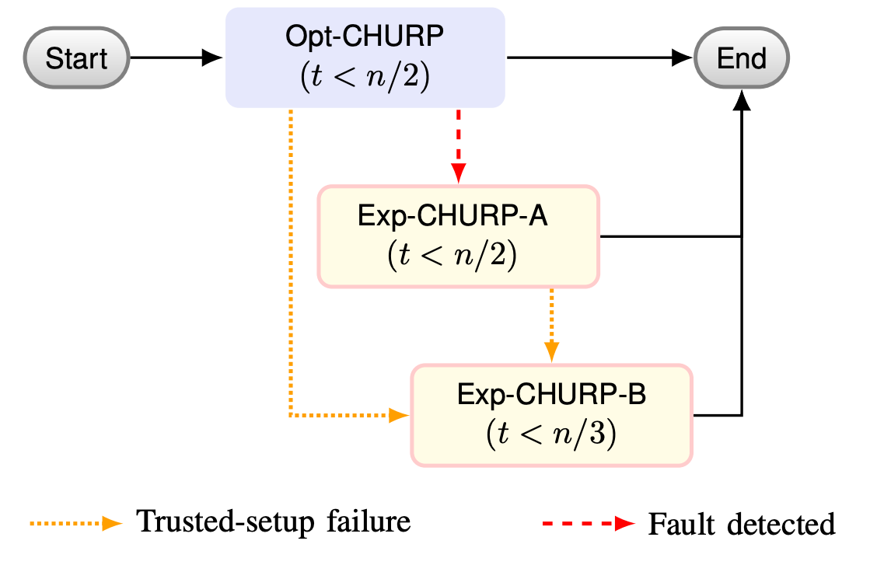
CHURP: a tiered protocol
Highly efficient optimistic path (O(n²))
Slower but more robust pessimistic path (O(n³))
Can also hedge against trusted setup failure!
By checking meta-invariants

Slide 14
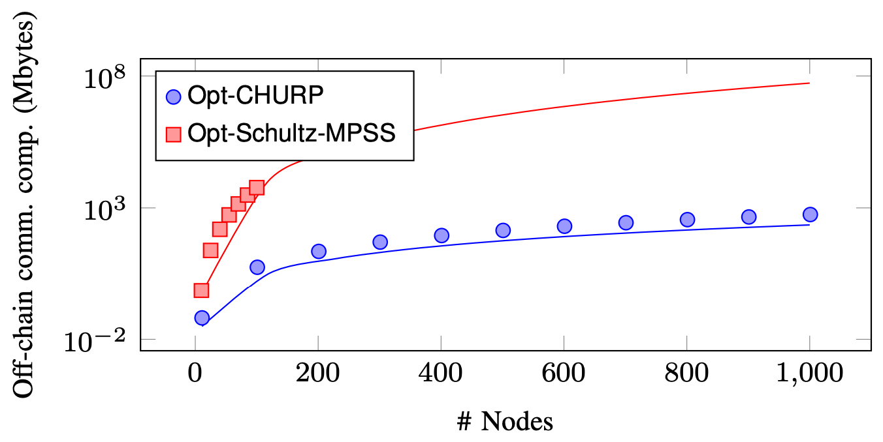
Performance
Communication complexity comparison
For 100 nodes:
Previously: 5.3GB
CHURP: 2.3MB
2300x improvement!

Slide 15
Lots of applications
Efficient secret sharing with node churn
Applications
Enable decentralized confidential smart contracts (e.g. Ekiden)
Decentralized Identity (DIDs)
decentralized secure multiparty computation (MPC)

